Slide 1
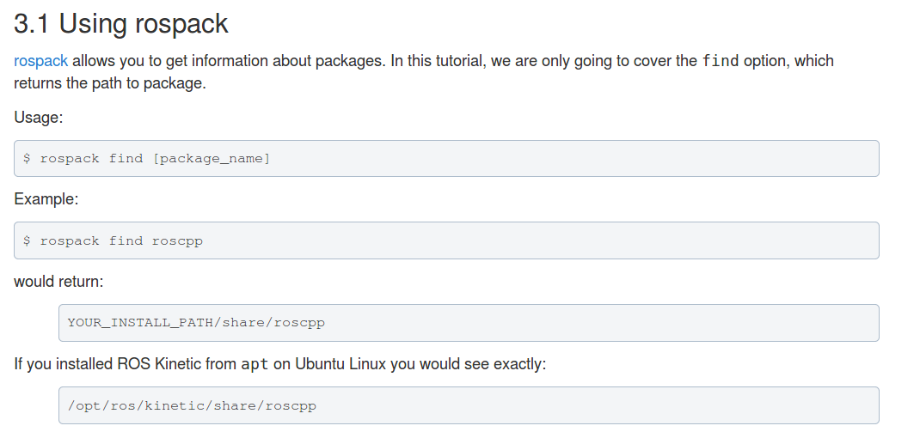
To find packages - Rospack find roscpp

Slide 2
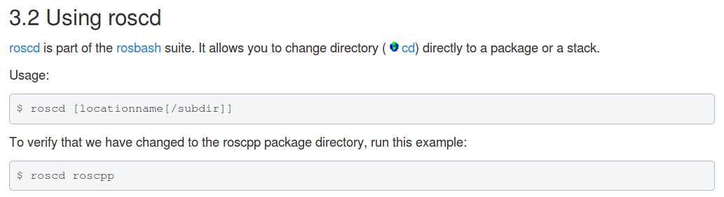
To navigate to package roscd roscpp

Slide 3
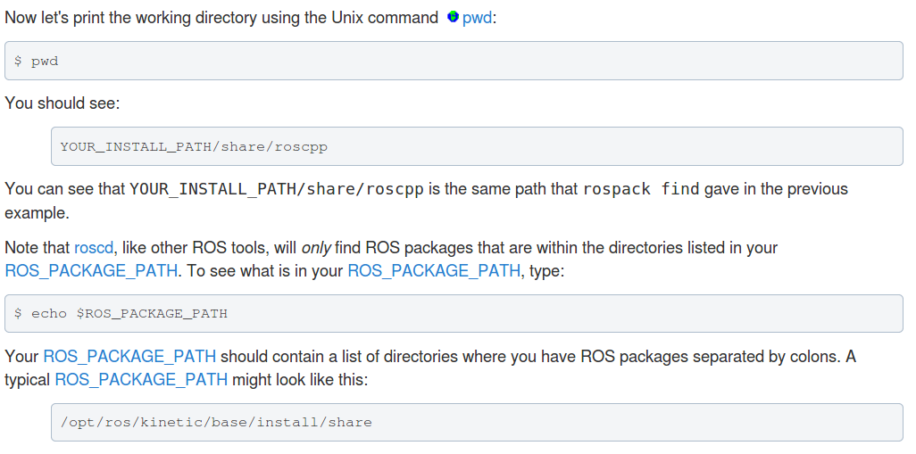
To find current working directory, to find ROS_PACKAGE_PATH : pwd, echo $ROS_PACKAGE_PATH

Slide 4
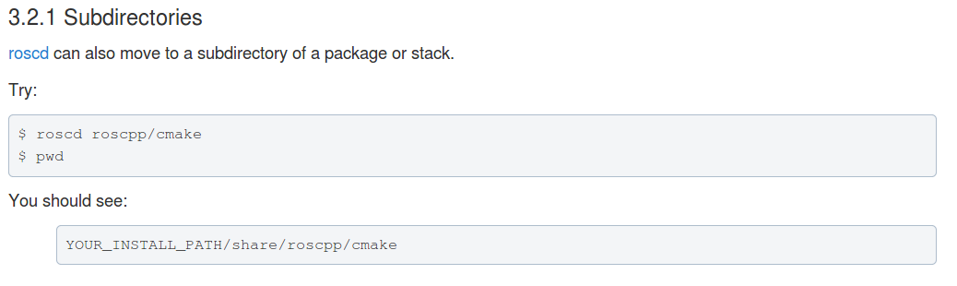
To move to a subdirectory of a path – roscd roscpp/cmake

Slide 5
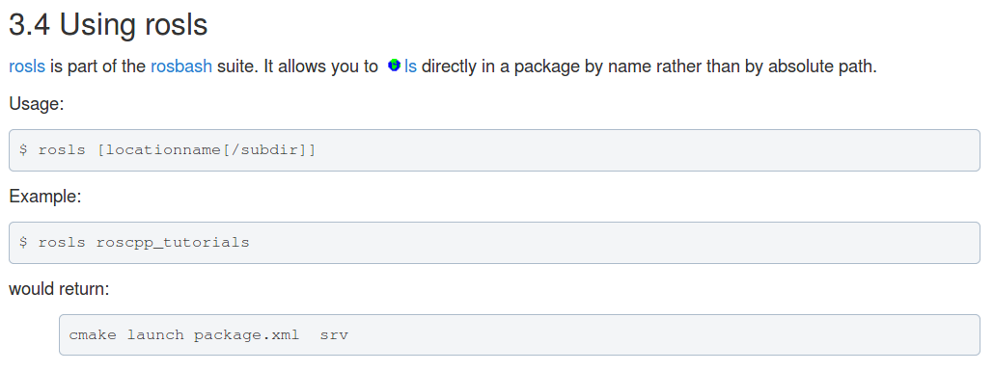
To find particulates of a path : rosls roscpp_tutorials

Slide 6

https://www.youtube.com/watch?v=J1qT85pTW0w

Slide 7
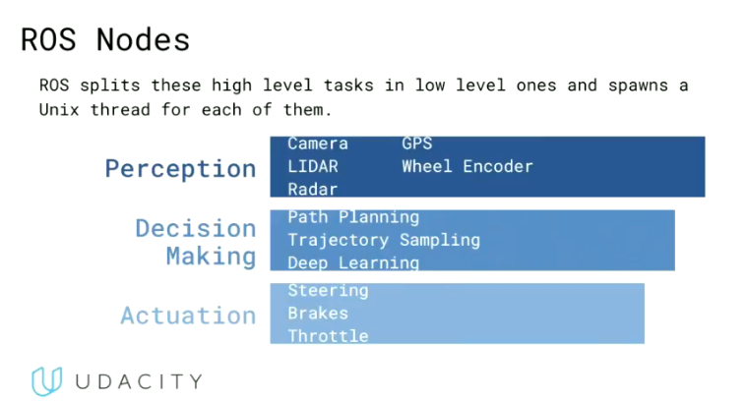

Slide 8
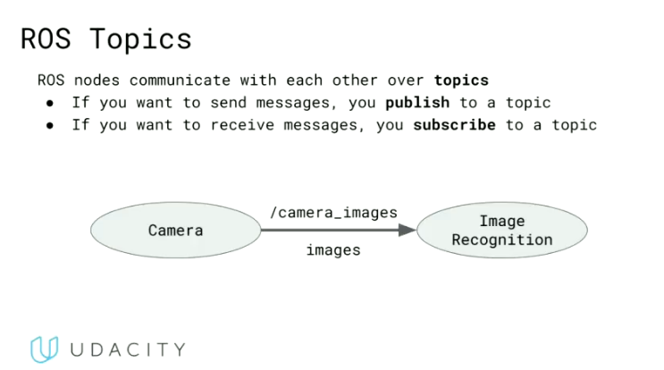

Slide 9
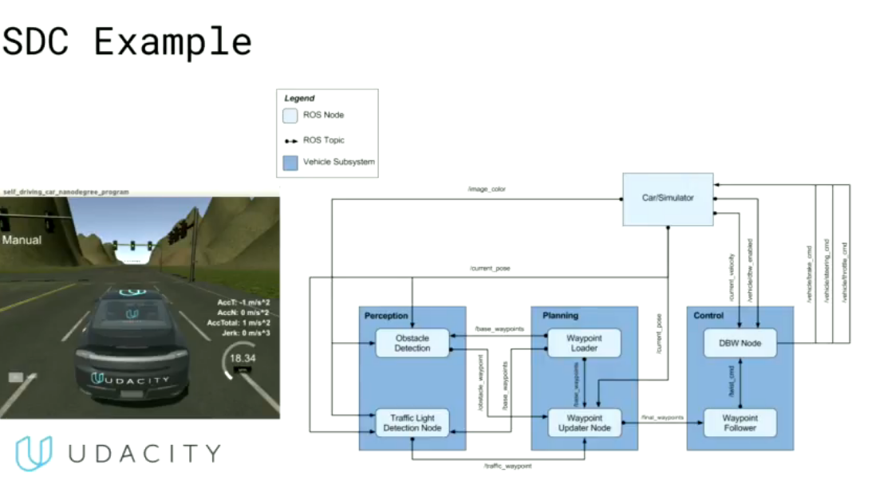

Slide 10
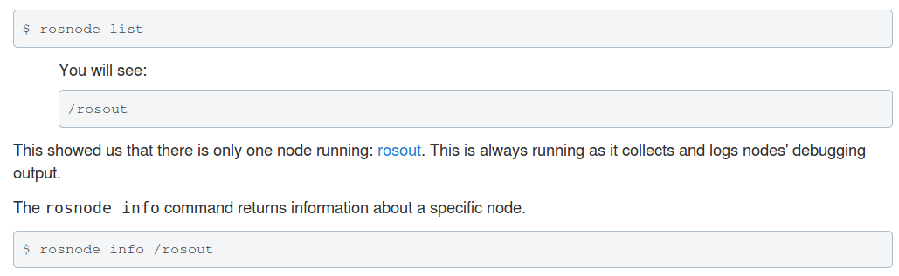
To see list of nodes running – rosnode list

Slide 11
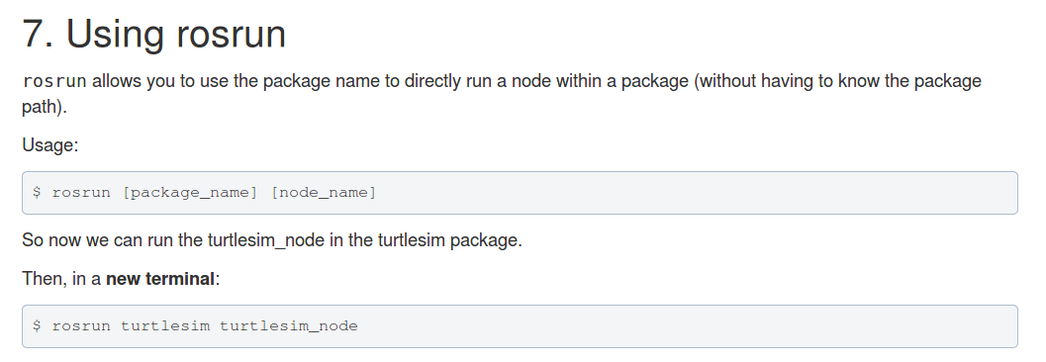

Slide 12
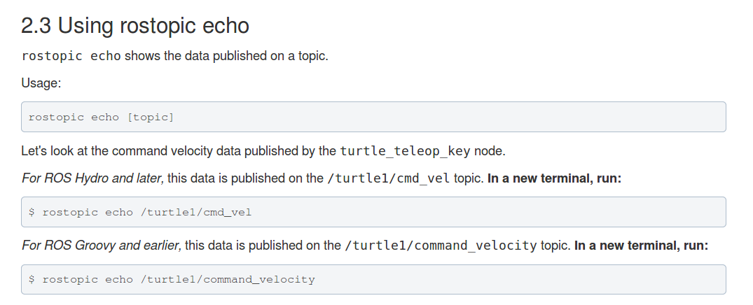

Slide 13
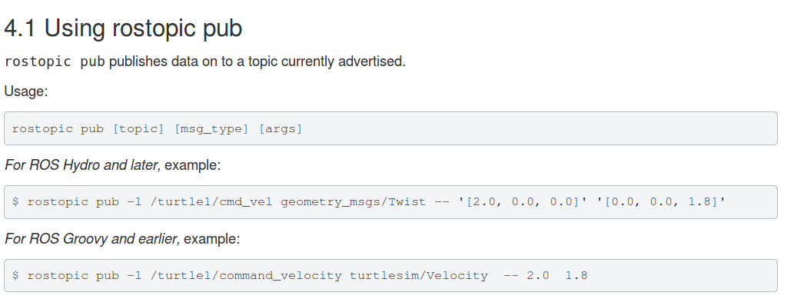

Slide 14
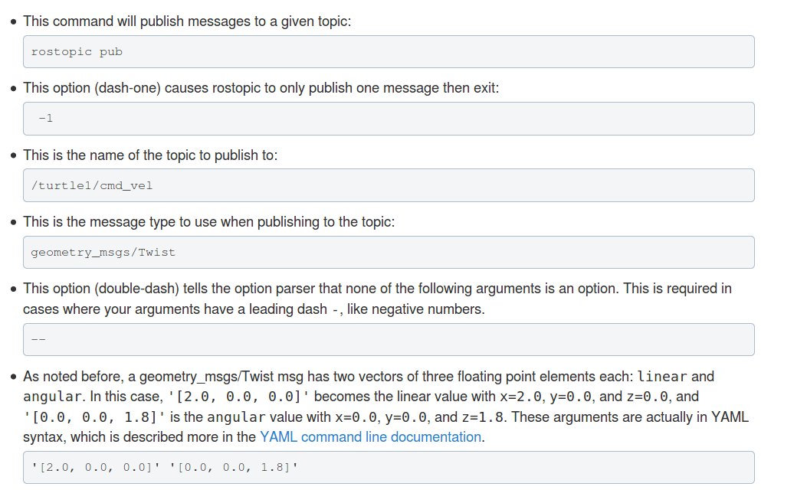

Slide 15
ROS example :
1. sudo apt-get install ros-<distro>-ros-tutorials – to install tutorial package
2. roscore
3. rosrun turtlesim turtlesim_node
4. rosrun turtlesim turtle_teleop_key
5. rosrun rqt_graph rqt_graph
6. rostopic echo /turtle1/cmd_vel
7. rostopic pub -1 /turtle1/cmd_vel geometry_msgs/Twist -- '[2.0, 0.0, 0.0]' '[0.0, 0.0, 1.8]'
8. rosrun rqt_plot rqt_plot
9. /turtle1/pose/x
10. /turtle1/pose/y
11. /turtle1/pose/theta

